Slide 1
Sentiment Analysis

Slide 2
Aim of the Project
We are going to perform Sentimental Analysis on an American retail companies specializing in home improvement where are main focus to is understand customer’s opinions on different products of Ceiling fans
Performing Sentiment analysis on the given will help us understand attitudes of people through text data.
Further it also helps us to understand people’s opinion regarding a specific product.
Scoring is done using polarity values that range from 1 to -1.
Values closer to 1 indicate more positivity likewise values closer to -1 indicate more negativity and values closer to o are considered as neutral

Slide 3
01
Data Description
02
Exploratory Data Analysis
03
Sentiment Analysis
04
Conclusion
Systematically described research data is the key to making the data findable, understandable and reusable.
It is an approach to analyse data sets to summarize their main characteristics, often with visual methods.
It’s the process of determining whether a piece of writing is positive, negative or neutral.
Various outcomes from the project and will refer recommendations to increase customer satisfaction

Slide 4
01
Data Description
This dataset contains product reviews and metadata of ‘Ceiling Fans' category from Homedepot and Lowes, including 1188 reviews spanning 1st January 2018 – 28th January 2020.
This dataset includes:
reviews (review_link, review_header, review_creation_date, review_rating_score, review_text)
product metadata (retailers, division, category , departments, brand, product_name, final_price_after_discount)

Slide 5
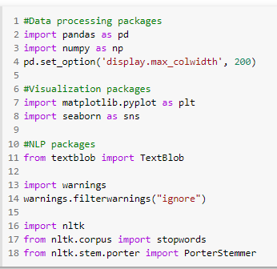
Importing Various Packages to perform various operations
Field Data
Rev_id = Customer viewer Id.
Retailer = Retailers selling the product
( Homedepot and Lowes)
Division = Types of product classification
(Lighting and Lighting and Ceiling Fans)
Departments = Classification by type
( Ceiling fans, Ceiling fans with lights and Ceiling fans without lights)
Product_URL = Specifications of the products
Product_Name = Types of Products ( 79 different products)
Brand = Name of various brands selling the product
(Harbor Breeze, Home Decorators Collection, Fanimation Studio Collection, Hampton Bay, Hunter, n/a)
Final_Price_after_Discount = Selling price of the product
Review_Link = refer link to review the comment
Review_Header = Gist of the review summary
Review_Creation_Date = Date when the post was written
Review_Rating_Score = Review Ratings ( 1 – 5 , where 1 being the lowest and 5 being the highest)
Review_Text = Opinions of customers regarding the product

Slide 6
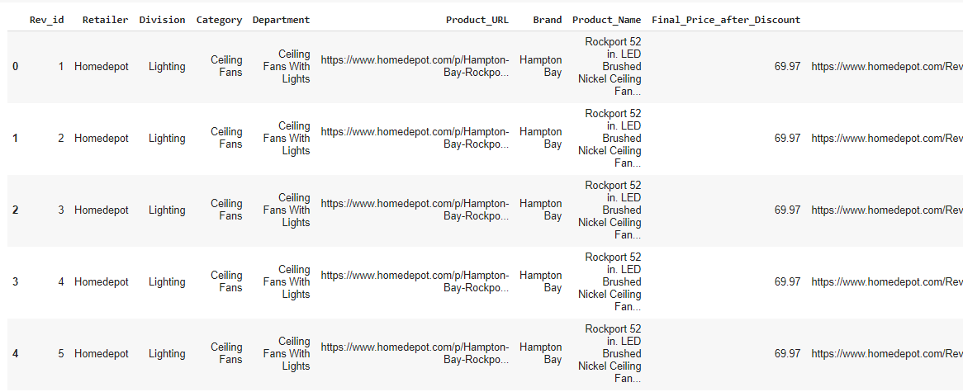
Loading the csv file.
Head function is used to display the dataset

Slide 7
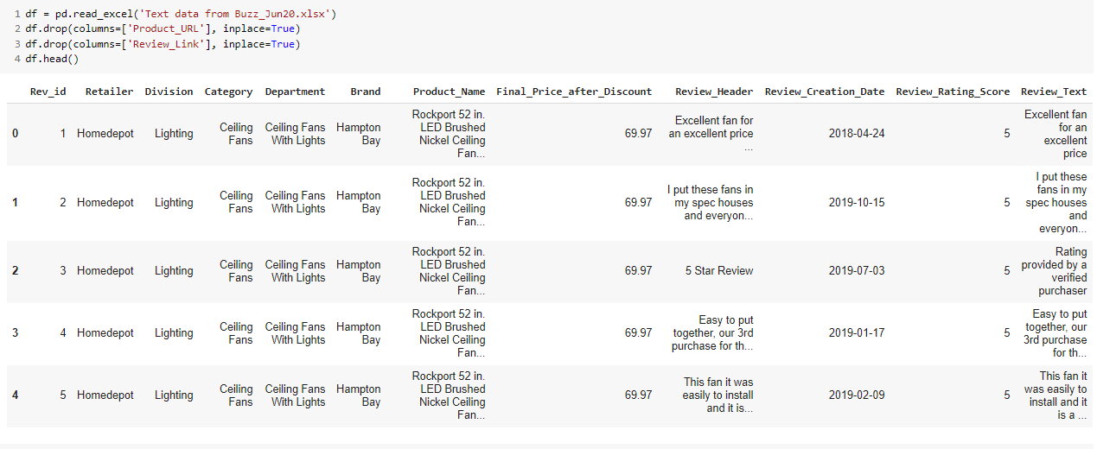
Here we have dropped the Product Url and Review Link and the data set is displayed

Slide 8
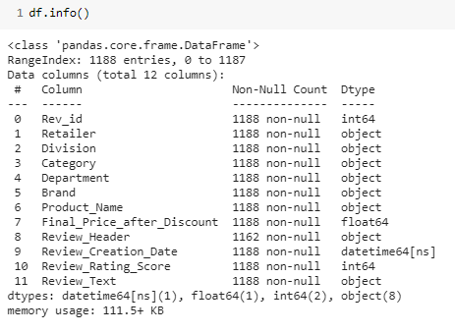
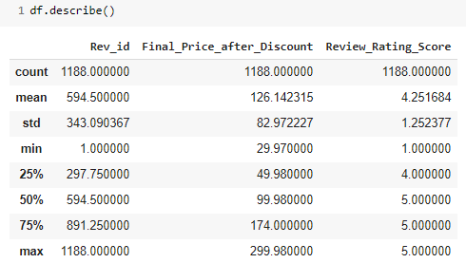
The below image describes the data based on count, mean, standard deviation, min and max values
The above image displays the various data types used, all count of value and whether or not the dataset has classified a particular column into null values

Slide 9
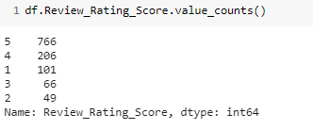
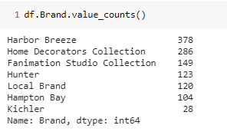
The image on the right describes total number of customer corresponding to each score
Rating Score are classified from 1 to 5 where 1 – lowest score and 5 – highest score
It is observed that nearly 80% of the customers have given rating above 3 and hence we can concluded that majority of the customers are satisfies with the product.
The image on the left describes the count of reviews for each brand
It’s observed that Harbor Breeze has received the highest reviews followed by Home Decorators Collection
Correspondingly Hampton Bay and Kichler have received the lowest reviews
Further analysis will help us to evaluate the reason behind these high and low reviews counts respectively

Slide 10
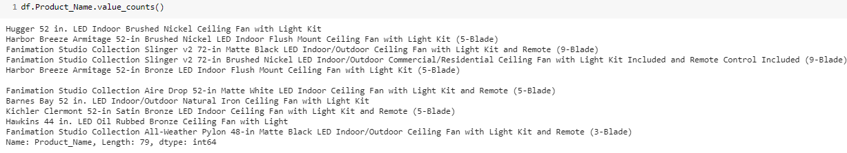
The below displays the name of 10 product names from the list and it can be seen from the last line that there are total 79 unique products sold by both the American Retailers
It’s also been observed in further analysis that the product sold by Homedepot and Lowes are different even if the brand remains the same

Slide 11
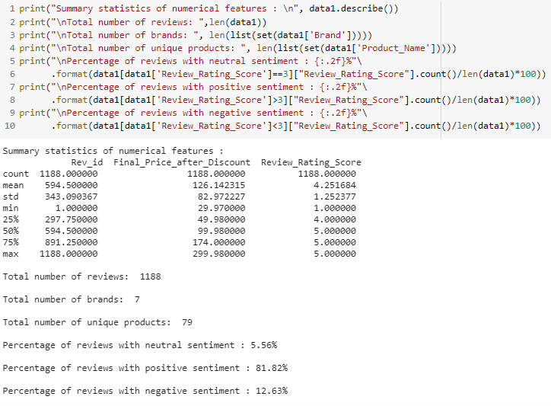
This images depicts some of the statistical features performed on the numerical data from the data set

Slide 12
02
Exploratory Data Analysis
Number of Reviews per Brand
Ratings Score Classifies based on Brand
No. of Record and Prices classified over Brand
Review count based on Score (Rating)
Top 10 products based on Reviews

Slide 13
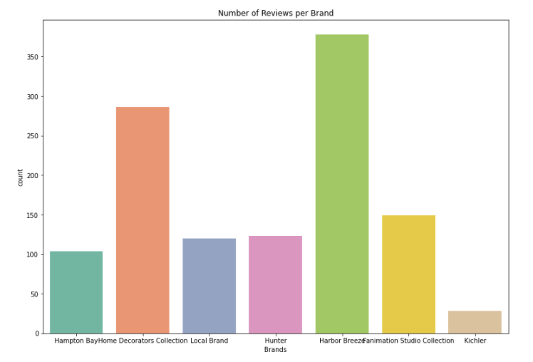
Number of Reviews per brand
Mercury is the closest planet to the Sun and the smallest one in the Solar System—it’s only a bit larger than the Moon
It is seen that Harbour Breeze and Home Decorators have received highest number reviews and Kichler has received the lowest.
To have a better understanding of this graph we have calculated the review score brand wise to understand which brand requires the call of action

Slide 14
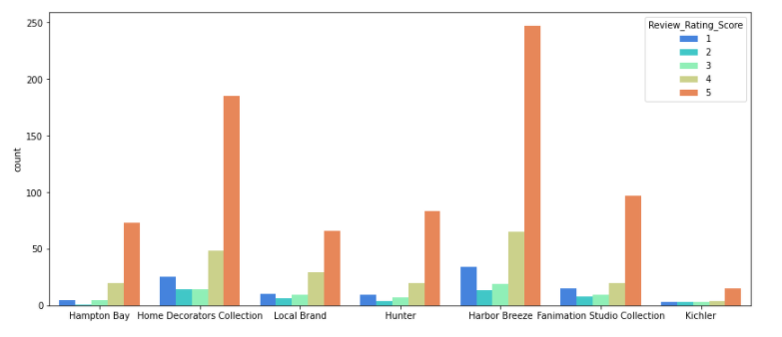
Score Count classifies based on Brands
It can be observed that Harbour Breeze product have received highest number of score followed by Home decorators.This mean the ceilings fans of Harbour Breeze are purchased by most of the customers .
Comparatively Kichler had a very low count of score compared to all the other brands, this can be because other brands have relatively more products in the market compared to Kichler

Slide 15
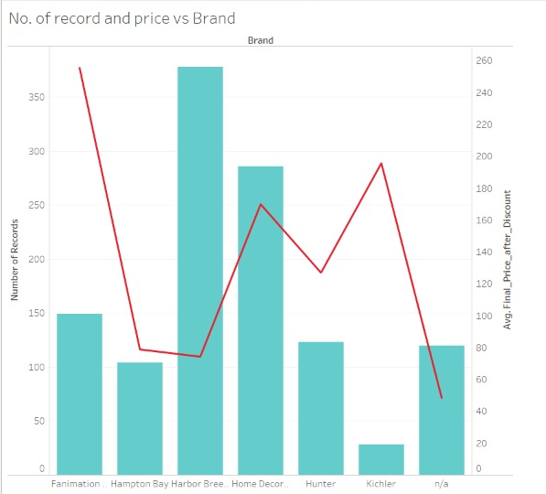
No. of Record and Prices classified over Brand
It is observed that the average price of Harbour Breeze products is low hence the number of customers buying their ceiling fans is high
Kichler have relatively highly higher average price hence less ceiling fans are purchased from this brand
Home Decoration Collection has twice as high average price compared to Harbour Breeze still there is a difference of around 100 customers buying less products from Home Decoration Collection

Slide 16
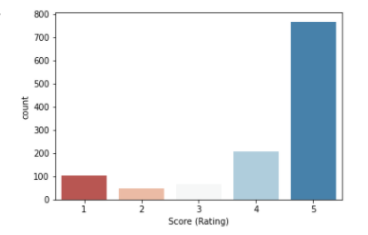
Review count based on Score (Rating)
Score (4,5) are denoted as positive ratings
Nearly 900 customers have given a positive ratings about the various ceiling fan products purchased
This also means that they are satisfied by services provided by the brand
Score (1,2) are denoted as negative ratings
Nearly 150 customers have given negative ratings which means brands need to focus on these type of customers, address their concerns and get them resolved.

Slide 17
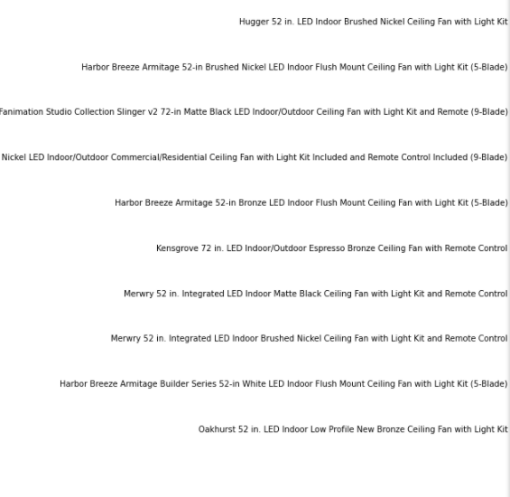
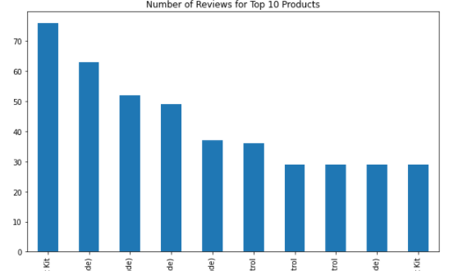
Top 10 Products based on Reviews
Highest Selling Products
Mercury is the closest planet to the Sun and the smallest one in the Solar System—it’s only a bit larger than the Moon

Slide 18
03
Sentiment Analysis
04
Conclusion

Slide 19
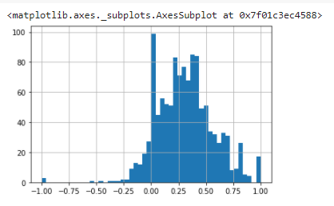
Polarity
Polarity helps us identify whether the textual words have positive or negative impact.
Graph clearly depicts that across 1188 customers giving reviews on 79 products of 7 classified brands have reviewed the product in a positive matter.
Though there is a spike seen which customers having neutral reviews about the product. These customers should be can easy target for the brand because they have to put in an effort to address their queries and shift them towards positive side.

Slide 20
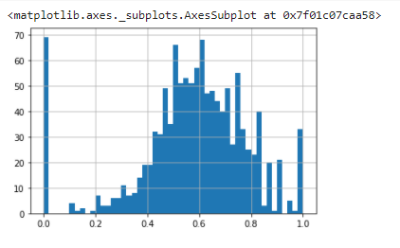
Subjective sentences generally refer to personal opinion, emotion or judgment whereas objective refers to factual information. Subjectivity is also a float which lies in the range of [0,1].
Subjectivity
Values that show 0.0 refer to that there are reviews given my the customers that based on factual information which is also called as objectivity.
These reviews are based on the true information about the product.
Values that show 1.0 refer to that these reviews are purely based on personal opinion, experience with the product.
These reviews keep changes from customer to customer.
Generally such reviews should not be taken into consideration

Slide 21
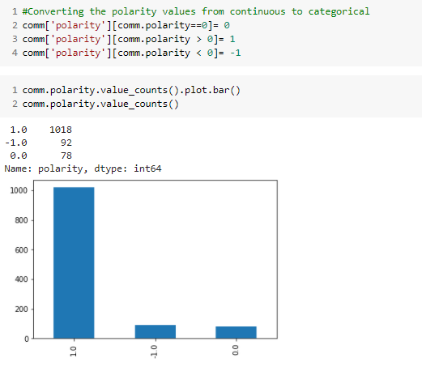
Bar Graph for Polarity
It is observed that 1018 customers have a positive opinion about the ceiling fans sold.
It can be concluded that the products sold by various brands are doing well in the market and people are liking the products
Hence, they have given positive reviews for the products
Nearly 90 customers have given negative reviews for the products.
Focusing on these comments the brands should address their concerns.

Slide 22
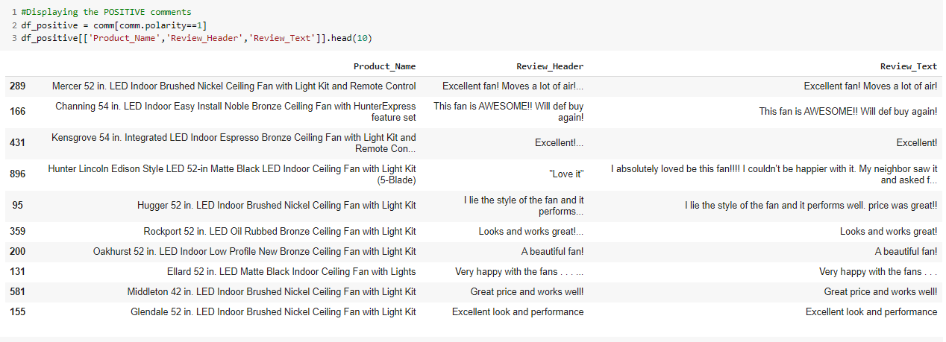
Word Cloud For only Positive Comments

Slide 23
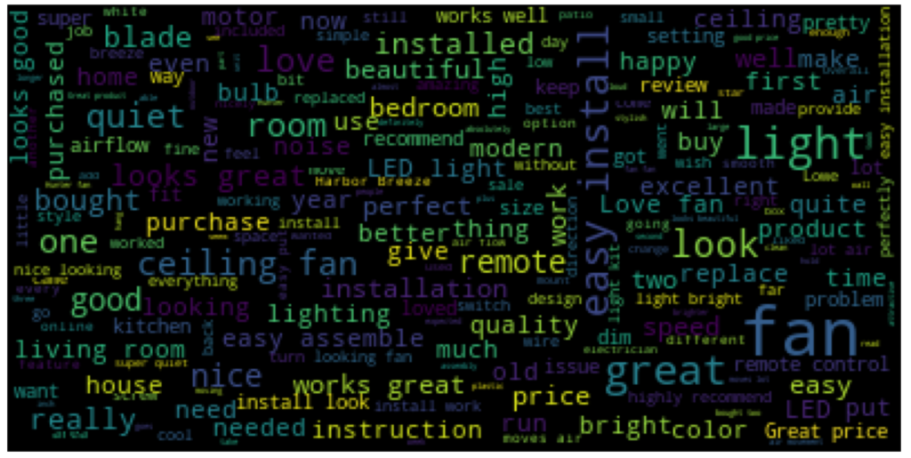

Slide 24
From the word cloud it is observed that easy installation is one of the most prominent word, it means that ceiling fans have easy installation
Mostly, ceiling fans are installed in the living rooms.
Also, it is seen that product are available in different shapes and sizes hence customers have a liking towards the product
Fans with LED lights are purchased mostly by the customers
Pricing has an a positive impact on the customers, this shows that price of the fans have impact on the purchasing power
Instruction are easy understood by the customers means manual have been made user friendly

Slide 25
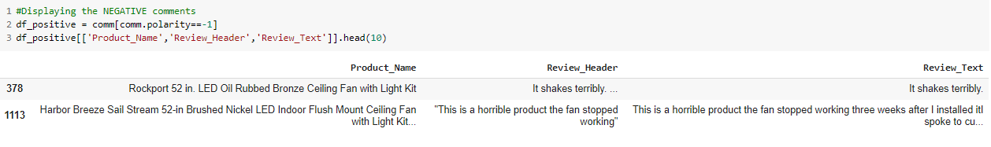
Word Cloud For only Negative Comments

Slide 26
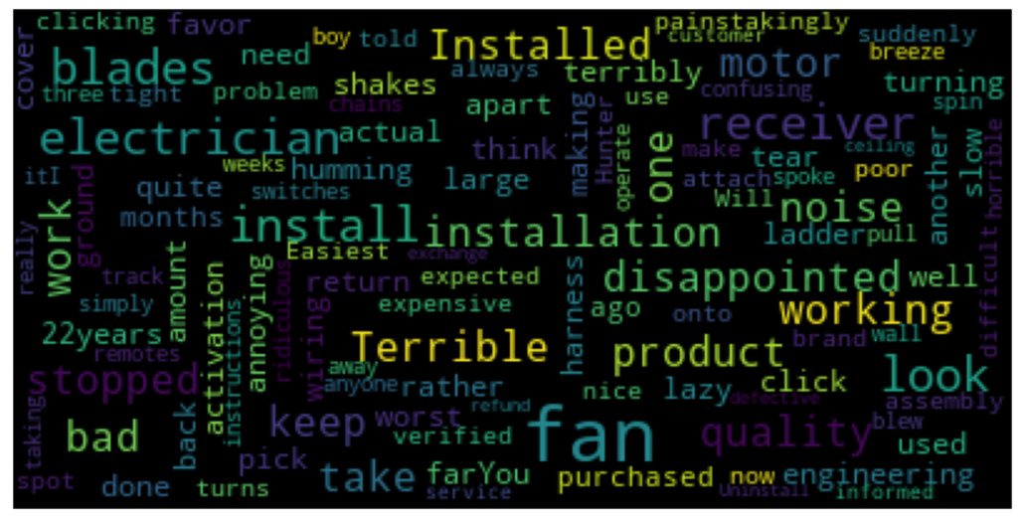

Slide 27
Comparatively with regards to negative comments people are facing a lot of issues with installation.
Electrician is also highlighted which means that there can been issues with operating the fans.
There is an observant humming sound and noise when the fan is switched on
Blades of the fans are can assembled properly which leads it to be shaky
The making of the product also doesn’t suit most of the customers.

Slide 28
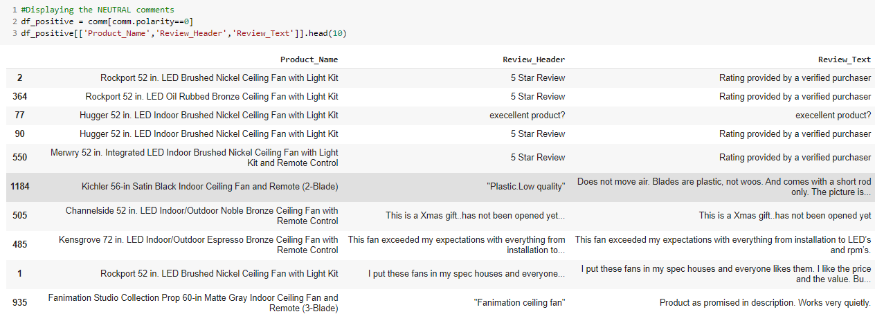
Word Cloud For only Neutral Comments

Slide 29
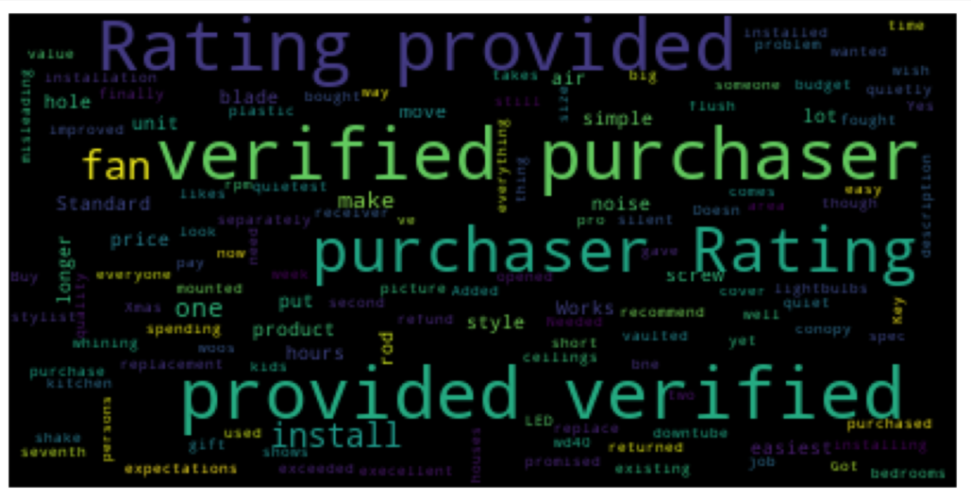

Slide 30
04
Conclusion

Slide 31
Comparing with the positive reviews it can be observed that customers are satisfied with the design, installation of the product.
Negative reviews related to the sound system as well as calling electrician is one issue observed that can be worked with the engineering of the product how it can be taken into being more easy to handle
Further classification of the reviews can be performed to understand which product is facing the highest number of negative reviews and how we can focus on performing improvements on those.

Slide 32
THANK YOU

